Slide 1
Addiction and Complex Trauma

Slide 2
Traditional treatment
28 days
5-10% success
Billions of taxpayer dollars
12-Step – 5-10% success
3 things are changing that
Clearer understanding of what addiction does in the brain
Clearer understanding of what sets up a person for addiction
Clearer understanding of the process – components and length

Slide 3
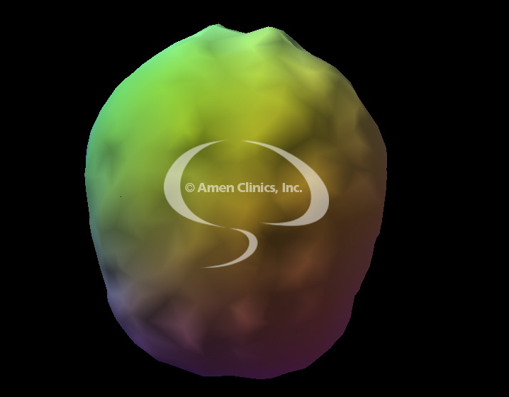
Healthy Brain

Slide 4
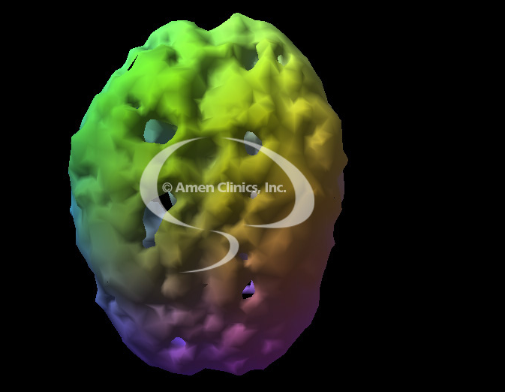
24 yr. old after 2 years of frequent cocaine use

Slide 5
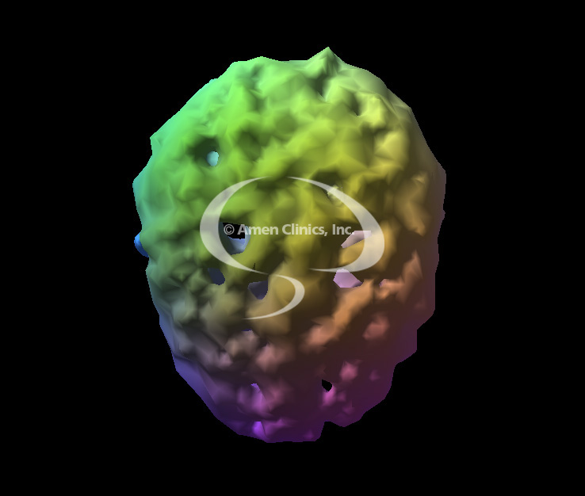
28 yr-old after 8 yrs of heavy Meth use

Slide 6
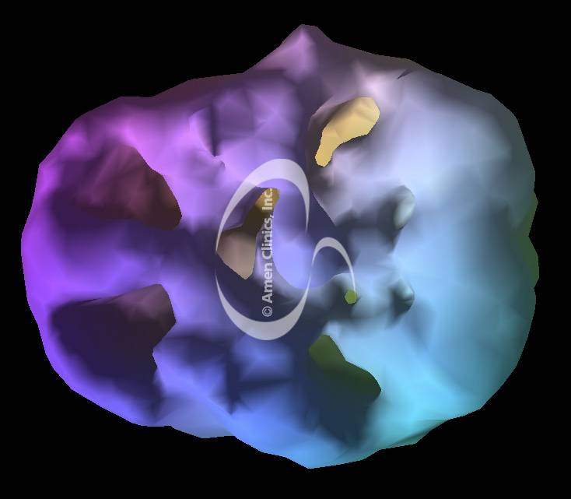
18 yr-old after 3 yrs of marijuana use 4 X/week

Slide 7
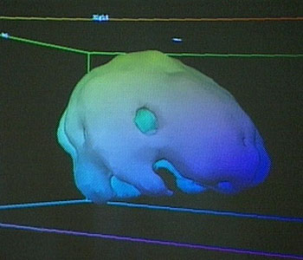
24 yr-old after less than 1 yr of Ecstasy

Slide 8
38 yr-old after 17 yrs of heavy wknd alcohol use

Slide 9
Brain’s Response to too much Dopamine
Committed to Balance
Adjusts/Adapts
Shuts down dopamine production
Chemically changes to reset normal

Slide 10
Before quitting drug use, and one year after not using

Slide 11
When a Person Quits
Powerful cravings
3-6 months of “anhedonia”
At 3 months, hit “the wall”
90% relapse
If stay clean for a few years then relapse
The brain gradually resets, but remembers

Slide 12
Marks of Addiction
Loss of Control
Obsession
Continued Use Despite Adverse Consequences
Tolerance
Withdrawal Distress
Guilt/Shame
Violates Morals and Values

Slide 13
Levels of Involvement
Non-involvement
Irregular Involvement
Regular Involvement
Harmful Involvement
Dependent Involvement
Psychological Dependence
Physical Dependence
NOTE: Once a person becomes physically dependent, they cannot return to regular involvement

Slide 14
Co-Occurring
About 90% of people with a mental health problem (ADHD, OCD, Clinical depression, Bi-polar, Schizophrenia, PTSD) end up with an addiction
Dual Addiction
Coffee and a cigarette
Two addictions where one feeds the other
About 70% of people with a cocaine or crystal meth addiction develop a sex addiction

